Slide 1
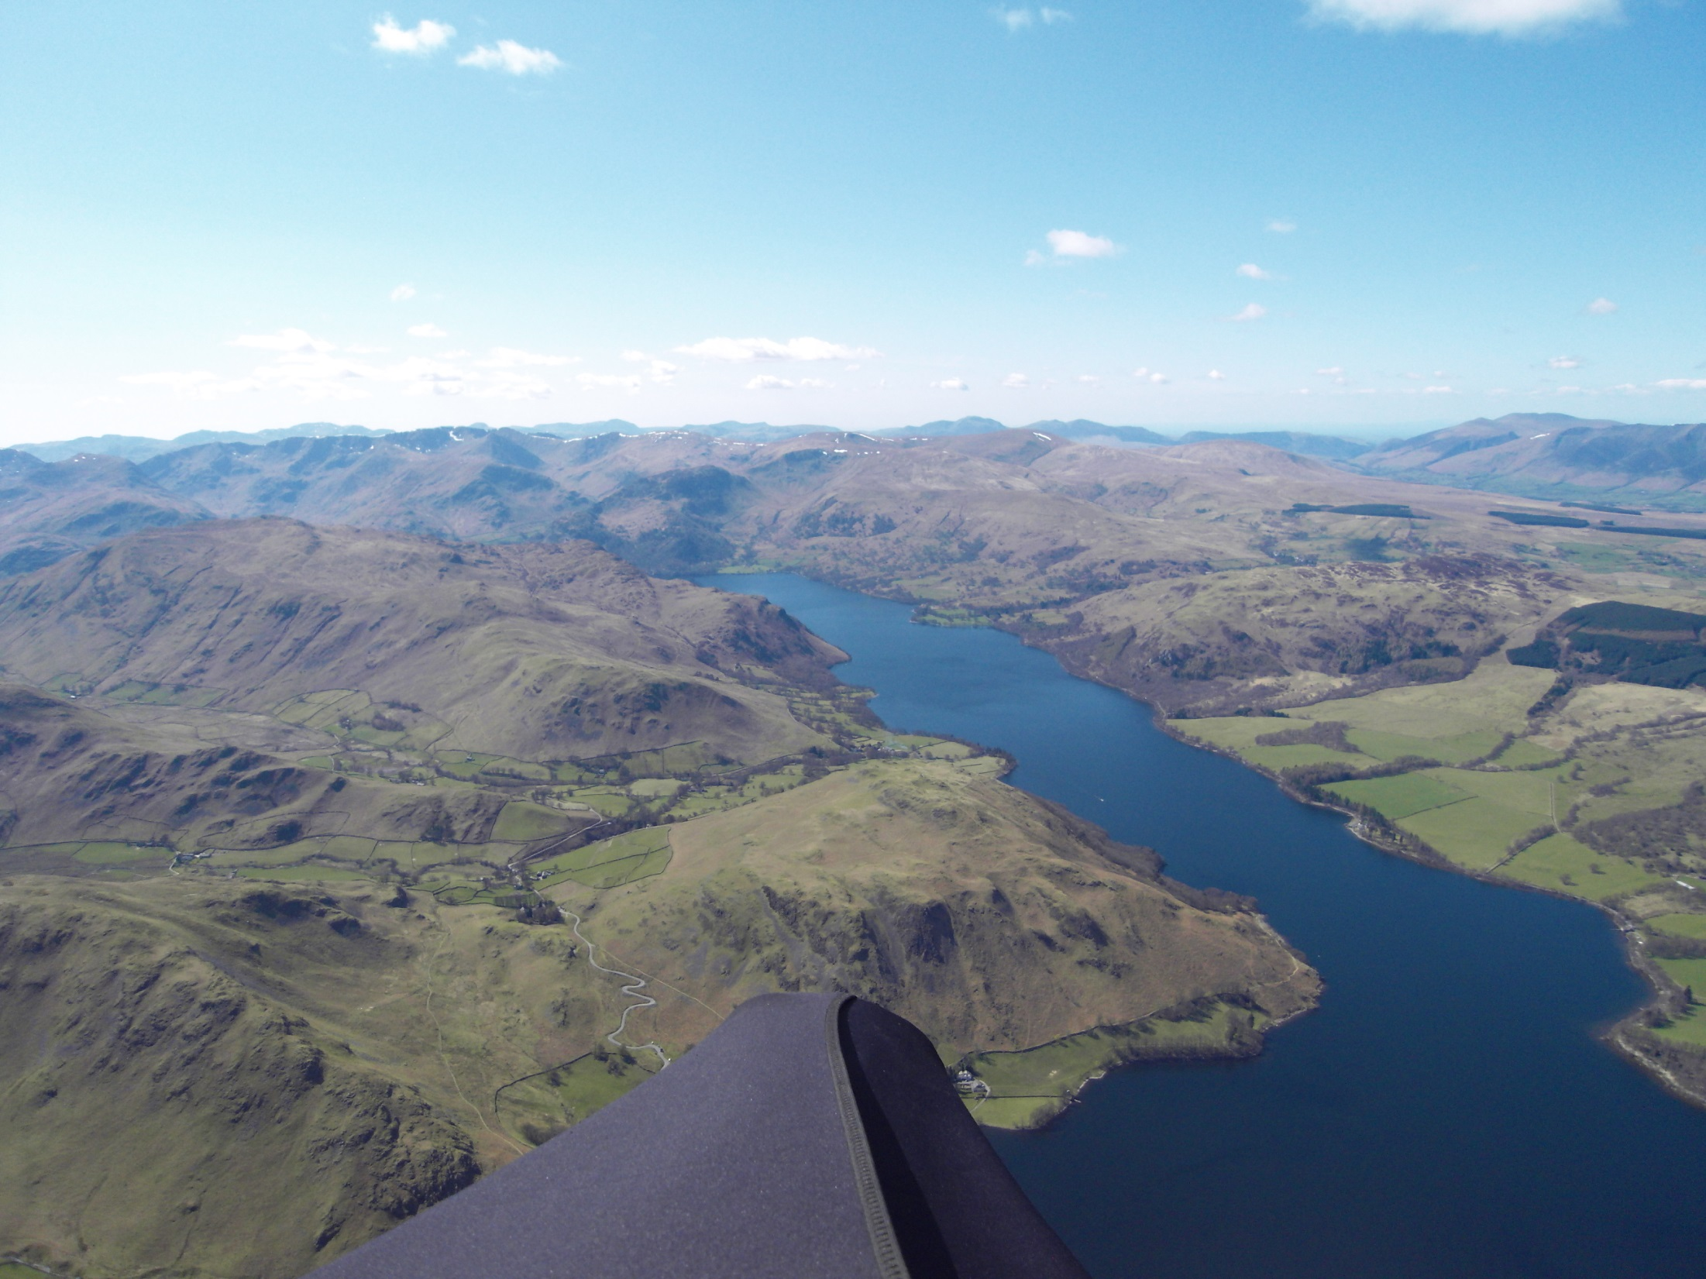
Joint Coaching Day 10th March 2013
Hosted by the CSC and DHPC Clubs
From CP to XC
An introduction to cross country flying
Lead persons: Dave Ashcroft & Ed Cleasby.
Support: Rick Livingstone
The day is intended to be as interactive as possible: please ask questions at any point.

Slide 2
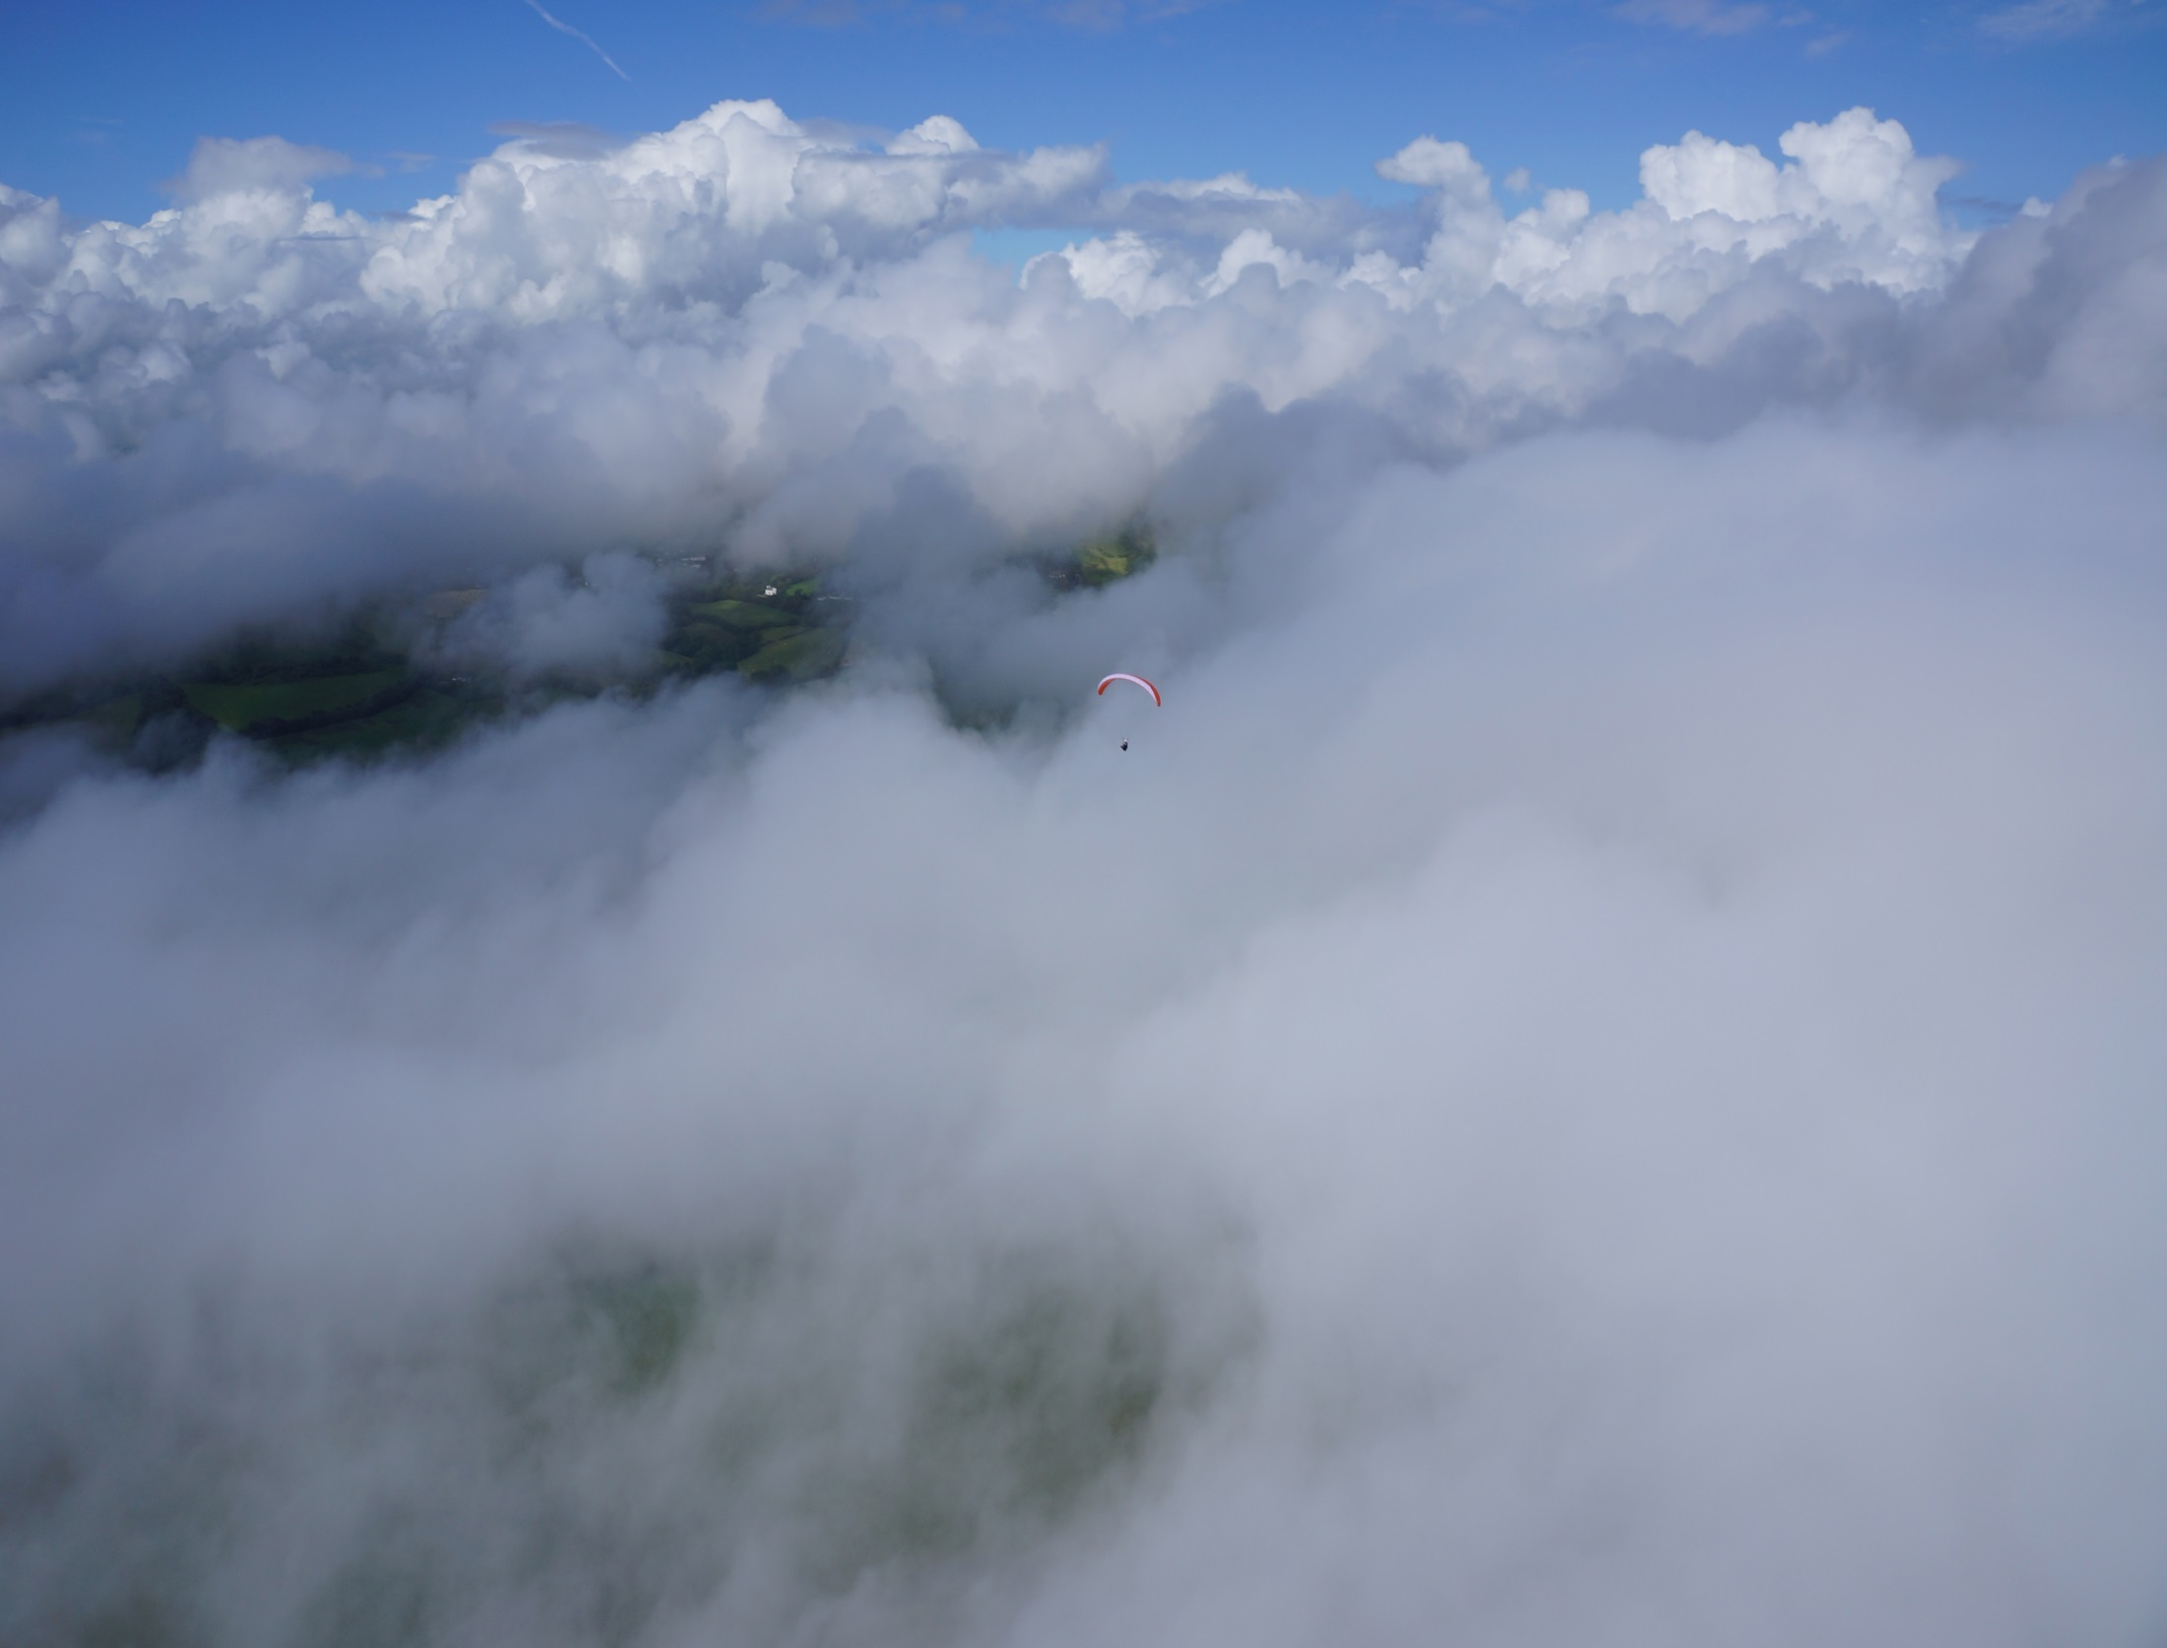
Programme (approx)
Start - 10:00: Welcome, Introduction and programme for the day
RL - 10:10: Group profile
The day will break down into approximately 4 x 1 hr slots with shorts breaks around 11:30, 12:45 – 1:30 lunch, 2:45 and finishing 4pm
The bulk of the day will be jointly covered by DA/EC and will focus on the following areas:
Why fly XC?
When are you ready for XC? Discussion topics
Mental blocks/concerns to going XC?
Going XC – the essentials
a) Mental and physical preparation
b) Reading the weather – identifying the good days
c) Selecting the best site – Dales/Lakes/Pennines
d) Equipment – instruments, radios, cameras
e) Planning and general flying skills/strategies
f) When to leave the hill
g) Choosing best lines/on glide – speed to fly
h) Finding the next thermal -observational skills
i) Reading and using clouds/terrain – third’s rule
j) Changing gear
k) Effects of wind and sun
Making effective use of Instruments
Airspace considerations
Planning your landing out – when/where
Judging terrain, slope and wind direction
Getting back!
Post flight reflection
Using flight information – tracklog/photos
Improvement strategies
q) Emergencies – use of 112/SPOT
PLENARY

Slide 3
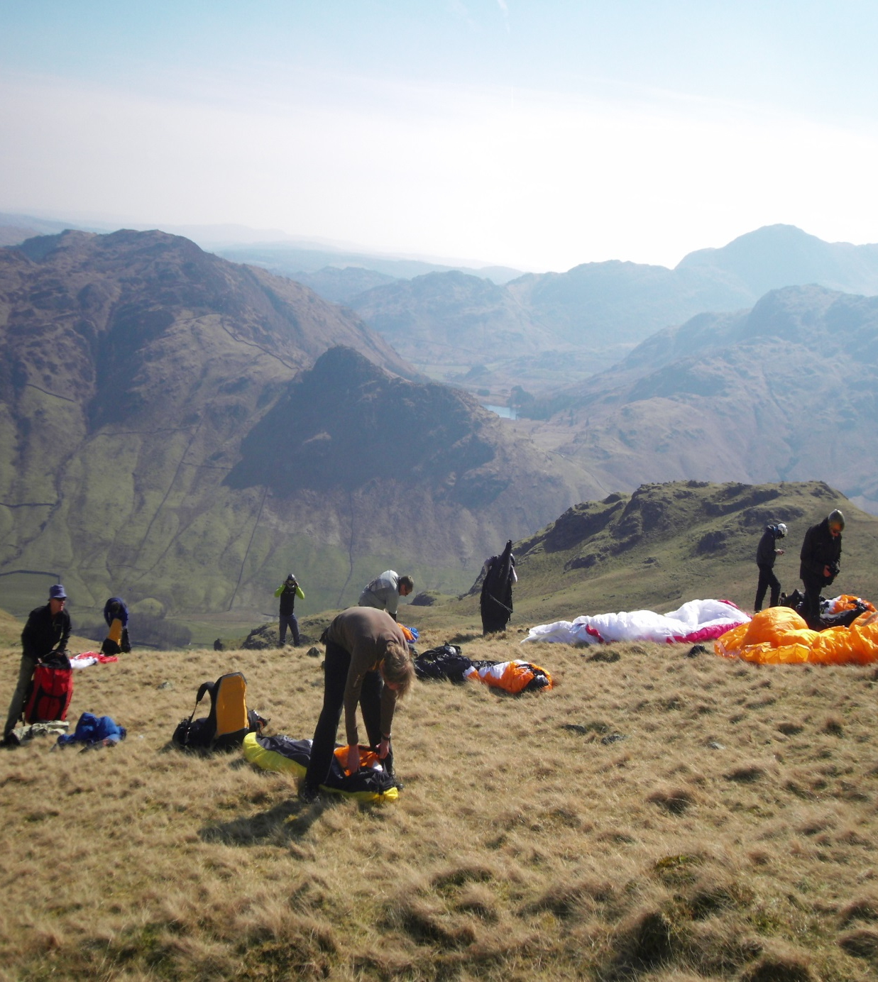
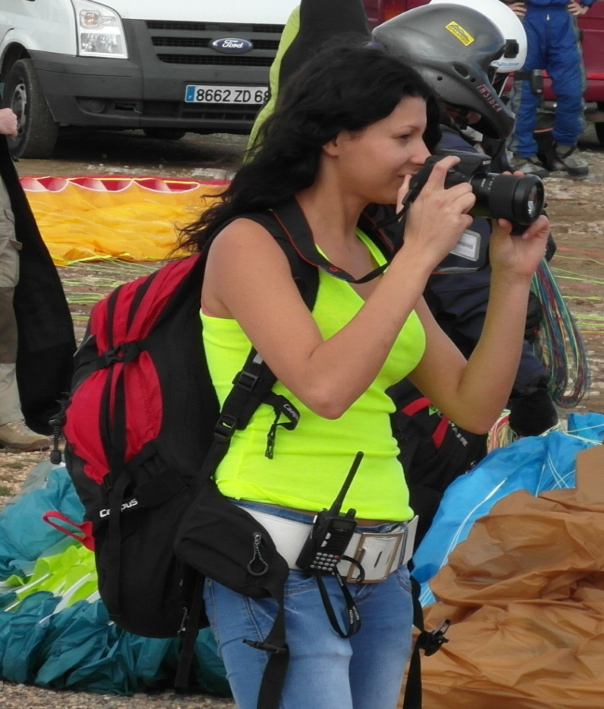
Mental preparation
Focused, avoid distractions
Positive frame of mind
Mental rehearsal of flight
Arrangements sorted
Relaxed
Physical preparation
Toilet break
Fluids
Food
Clothing (dress for altitude)
Charged batteries
All equipment checked
a) maps
b) phones
c) money/cards
d) hitching signs

Slide 4
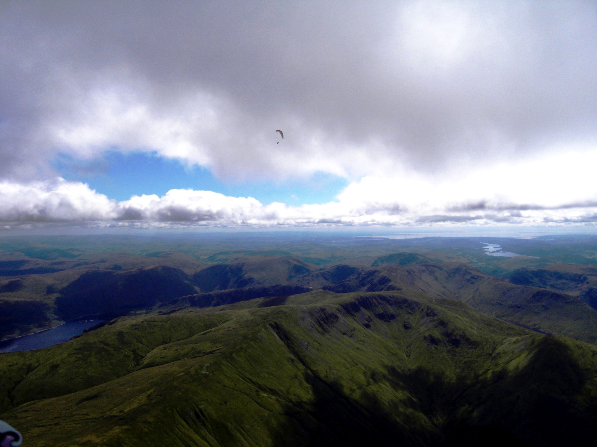
Reading the weather – identifying the good days
A good day has:
A good clean air mass , often post frontal
Winds between 8 – 15mph and fairly constant with height
A decent cloudbase, at least 4000’ + (5500’ to 6500’ is good in the UK)
Limited over-development and not too unstable
No strong inversion that is reluctant to lift or break
Plenty of sun on the ground

Slide 5
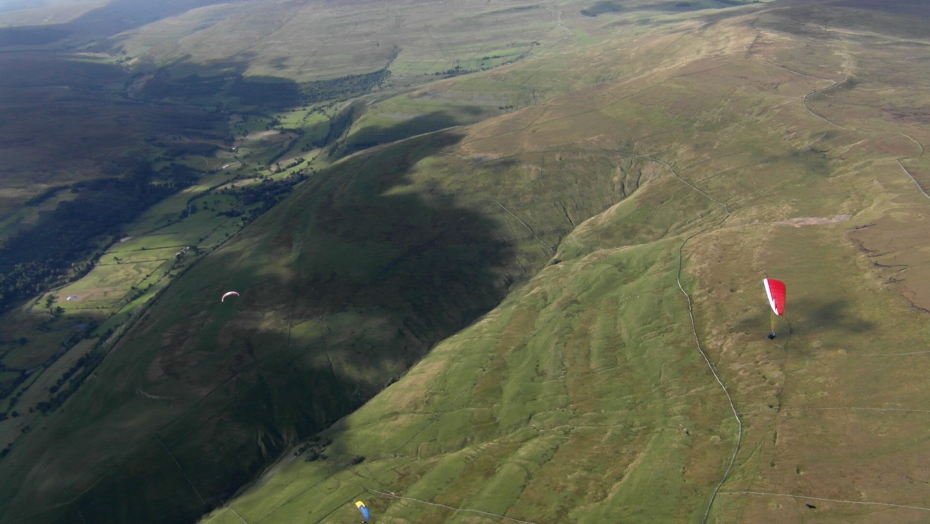
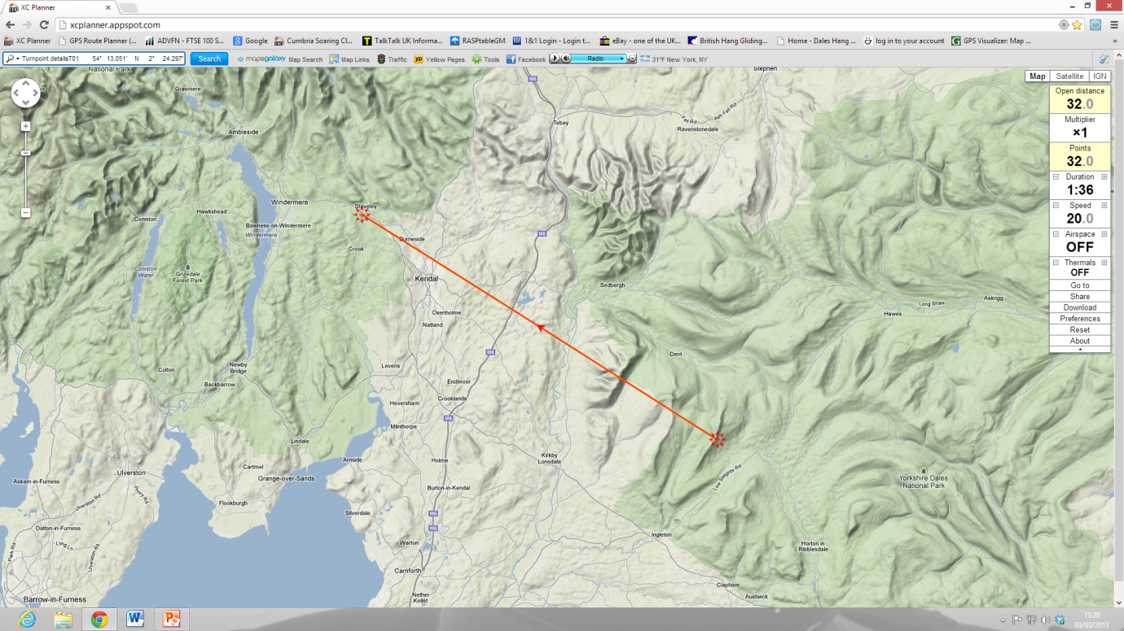
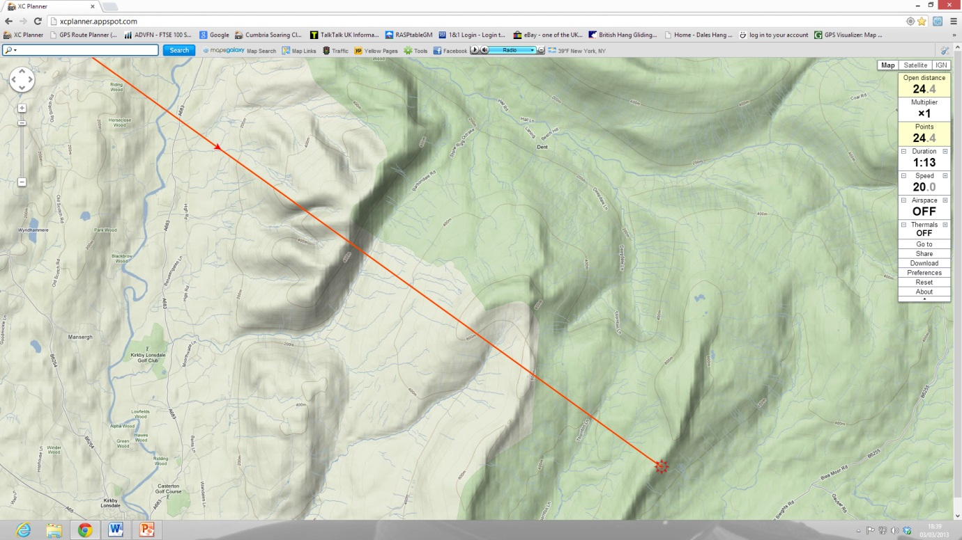
Selecting the best site
Known good thermal/xc site
Stress-free terrain downwind
Proven thermal course/respite ridges
Easy start early in flight
Likely to have company
Free of major restrictions
Plenty of good landing options
Mobile signal down route

Slide 6
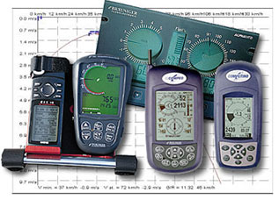
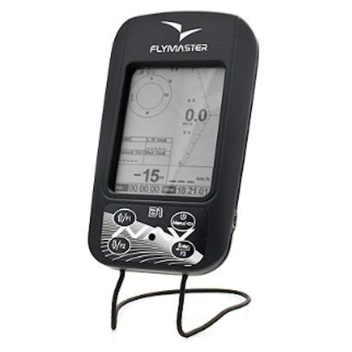
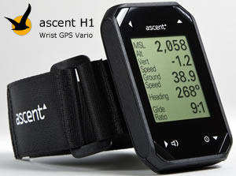
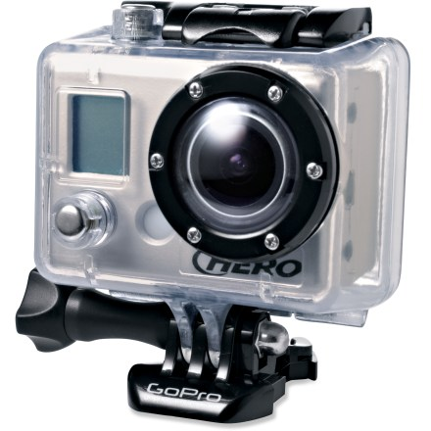
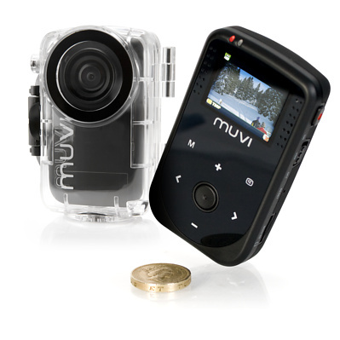
Instruments
Flight information – fields(?)
Navigation
Communication
Fairly straightforward to use
Capable of producing 3D tracklog
Good battery life
Visual recording
a) stills/HD movie – Go Pro/Muvi/Drift etc

Slide 7
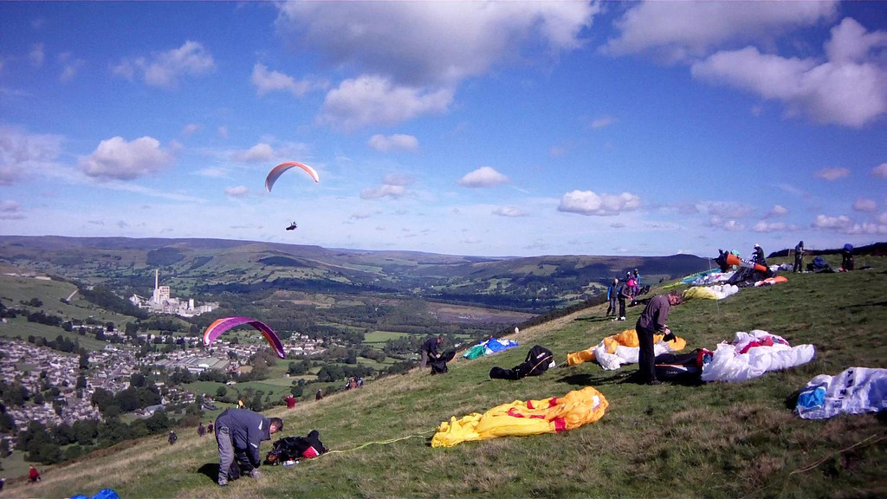
Flight planning and general flying skills/strategies
Pre-flight route planning
Reduce in-flight workload
Study maps/know the terrain
Some idea of line and likely thermal
sources and triggers
Retrieval and arrangements made
Hazard areas
Know landing out areas
General flying skills/strategies
Where/when to take off
Searching for the climb out
Working with others
Thermalling with others
Observational skills
Re-locating a lost climb

Slide 8
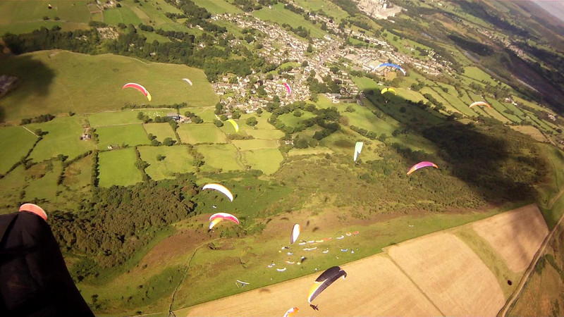
When to leave the hill?
Get a feel for the day first
Mentally comfortable
In a solid climb
The sky downwind
A reasonable cloudbase
The amount of sun on the ground downwind
A good size quality/gaggle
Listen to radio chatter
Beware! gaggle with good pilots will leave you behind after
only the second thermal

Slide 9
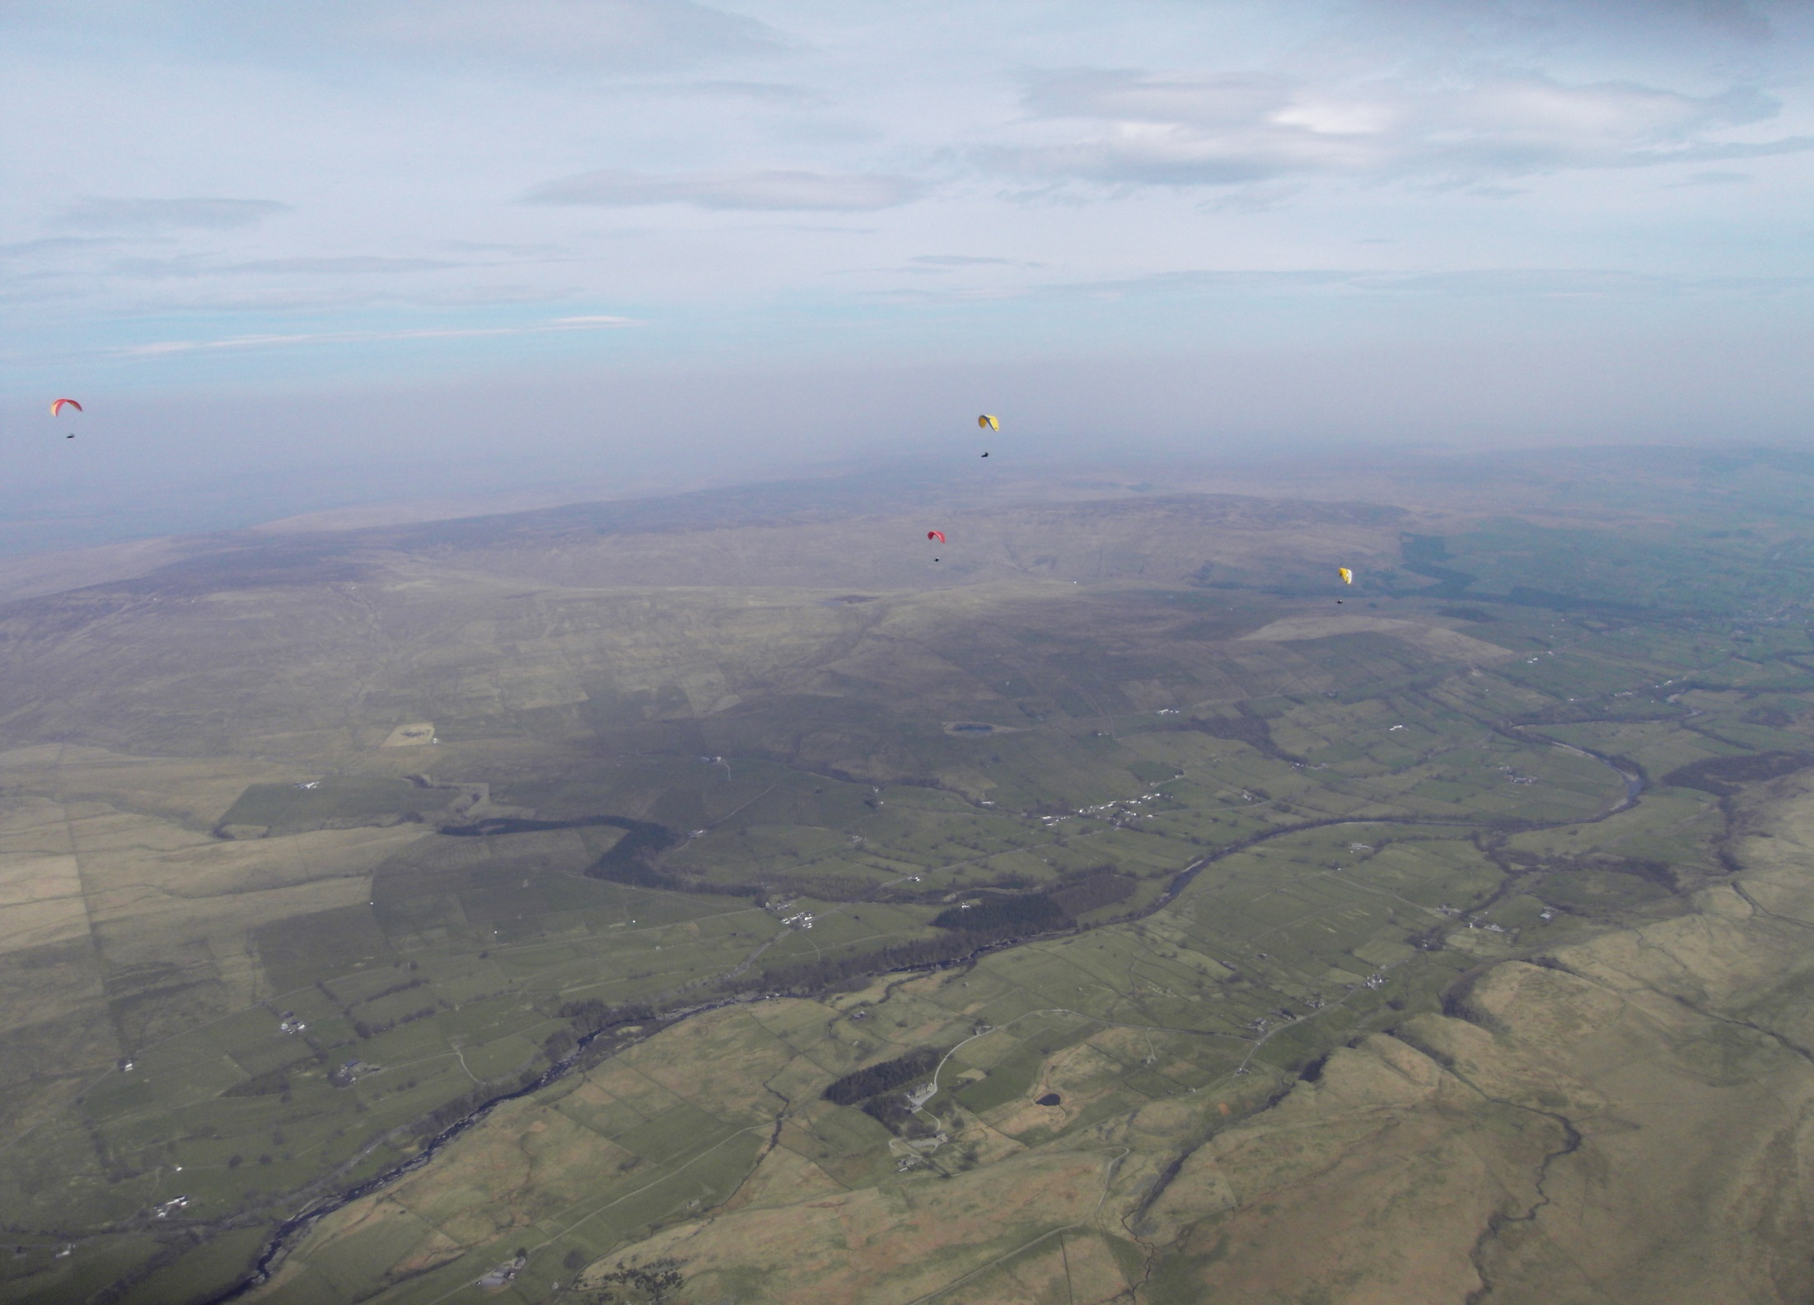
Choosing the best lines – on glide/speed to fly
On glide - search formation – spread out, line abreast
Compare your line with others
Line up several cloud/ground sources
Resist bar unless in heavy sink/racing
Glide more important than speed – know your polar curve

Slide 10
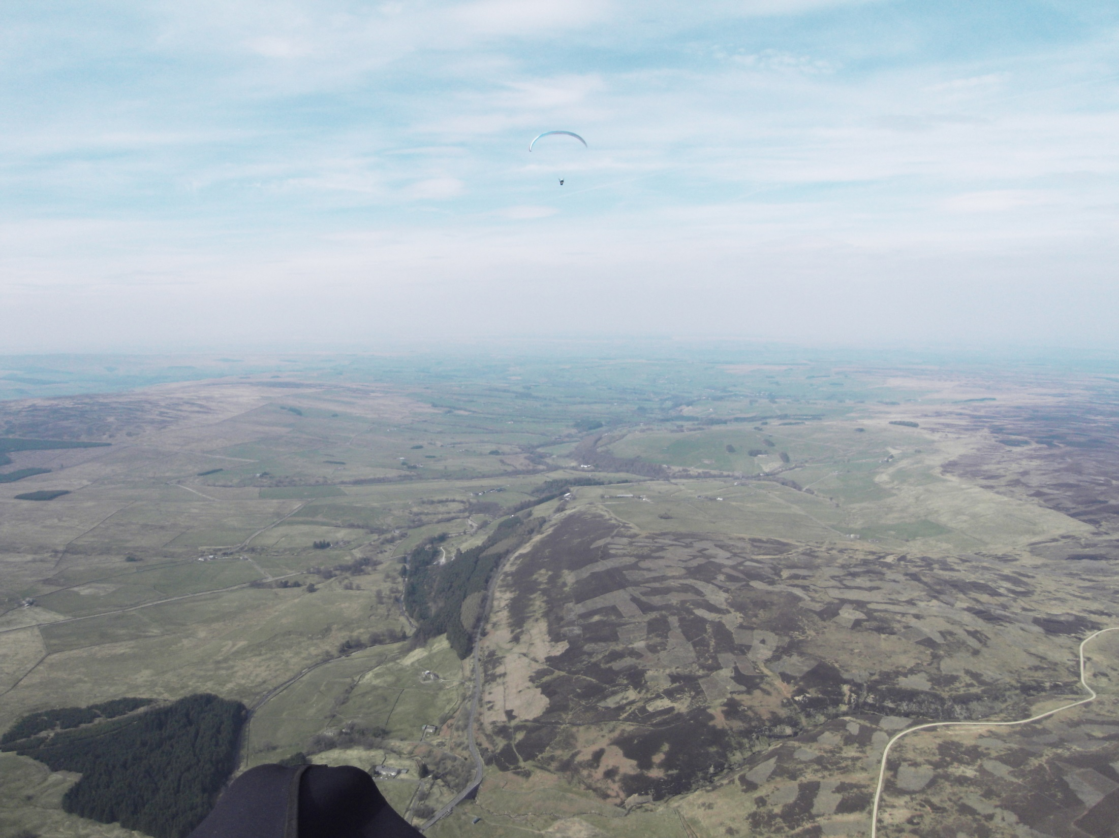
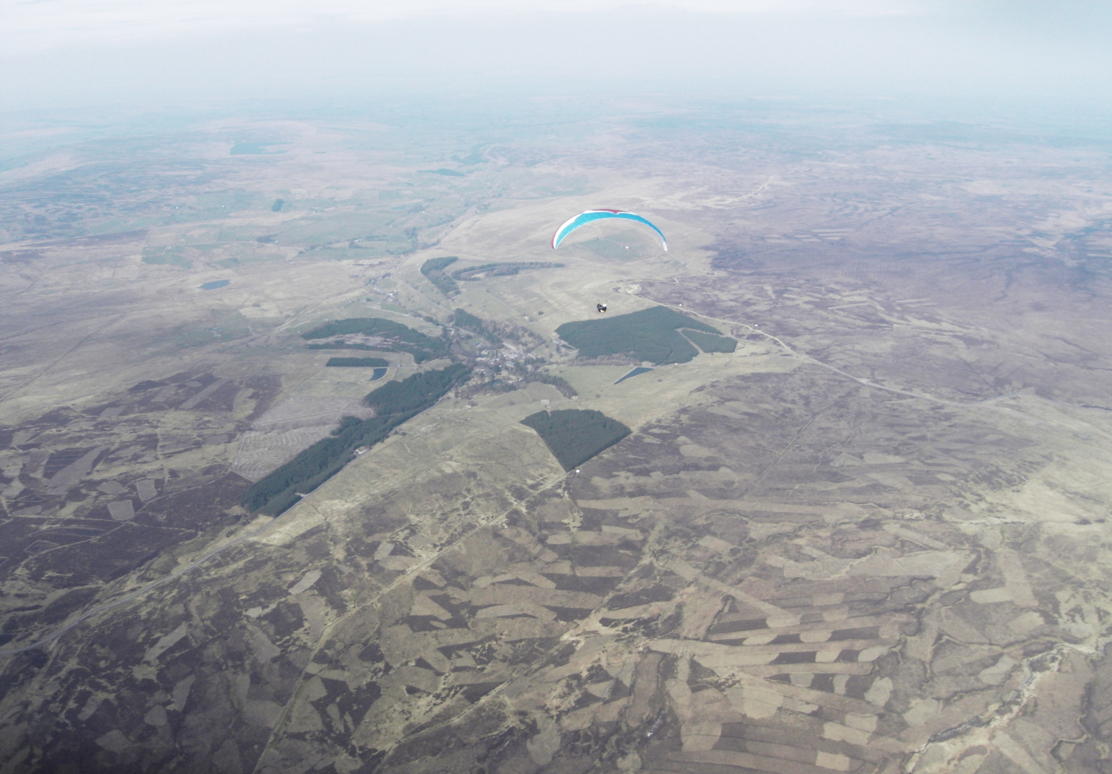
Find the next thermal – observational skills
Reading terrain – albedo values
Thermal sources
Thermal triggers
Reading clouds
Stages of development
Using cloud shadows for sky map
Cautionary note
The power of good observational skills
birds, smoke, water patterns, other gliders, cloud shadows, crops sun, etc

Slide 11
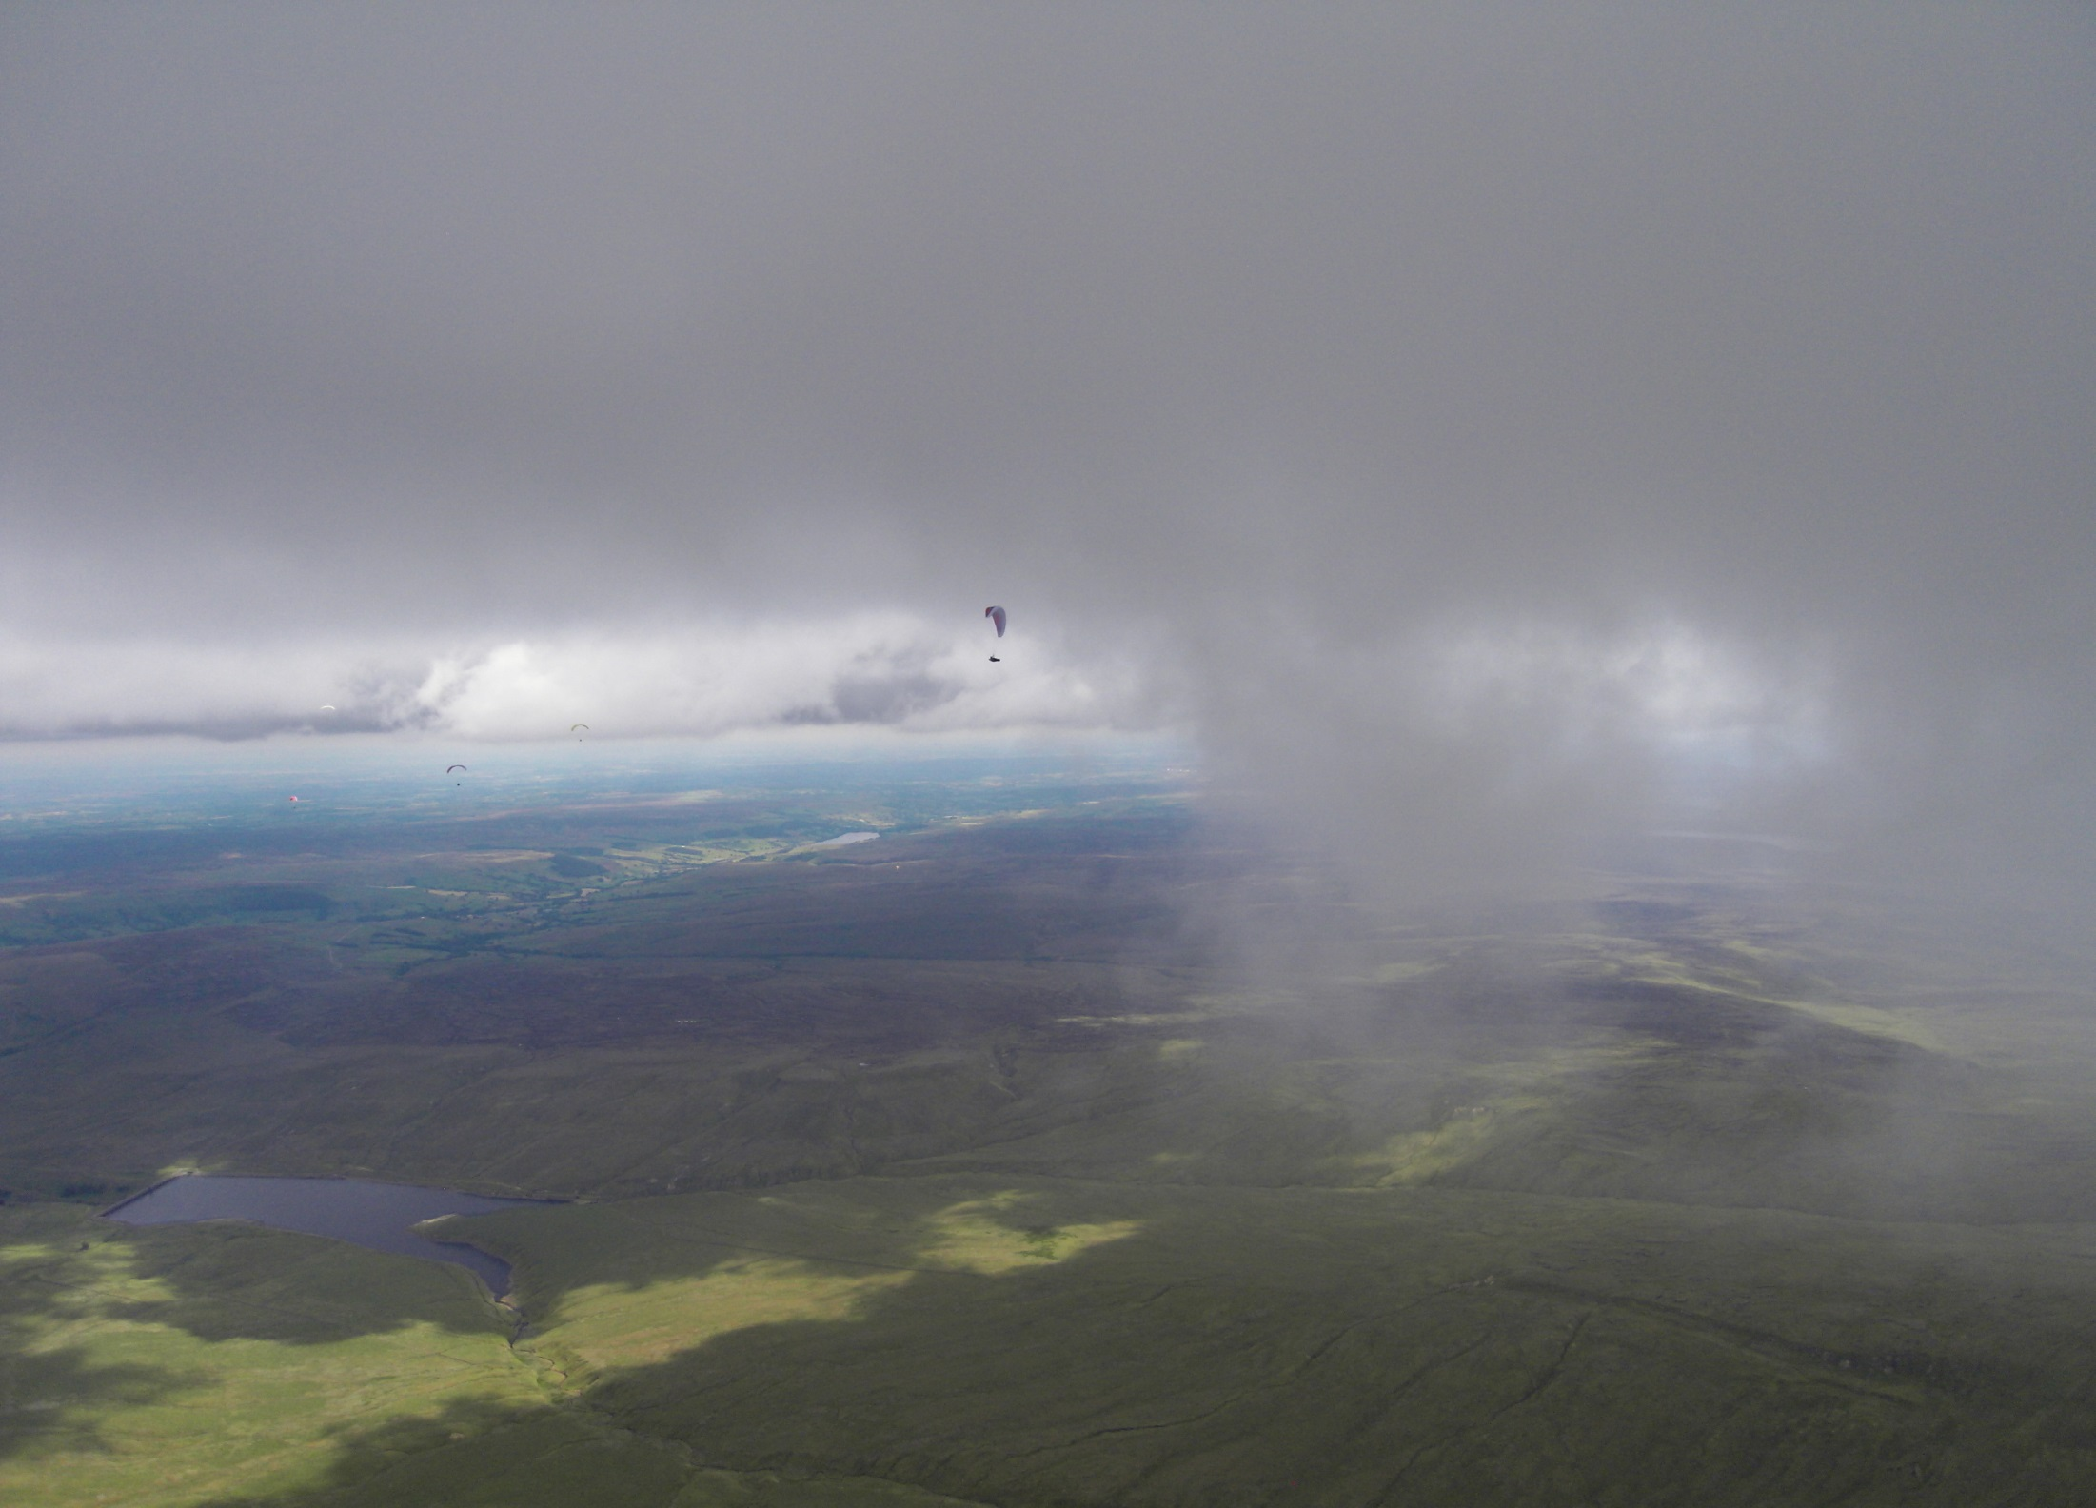
Reading clouds/terrain
Reading clouds (using clouds in the middle/top third)
Visual indicator of atmospheric conditions – airmass, humidity, thermal heating, fronts, etc
Infinite sizes, shapes, strengths – to non-visible (blue thermals)
The ‘classic’ cumulus provide excellent stepping stones to progress (thermal mapping)
Using cloud shadows
Assessing clouds in terms of thermal strength/remaining life/safety
Cloudbase heights – changes over time
Thermal strength – changes over time
Avoiding going into cloud - actions
“What goes up must come down …….”

Slide 12
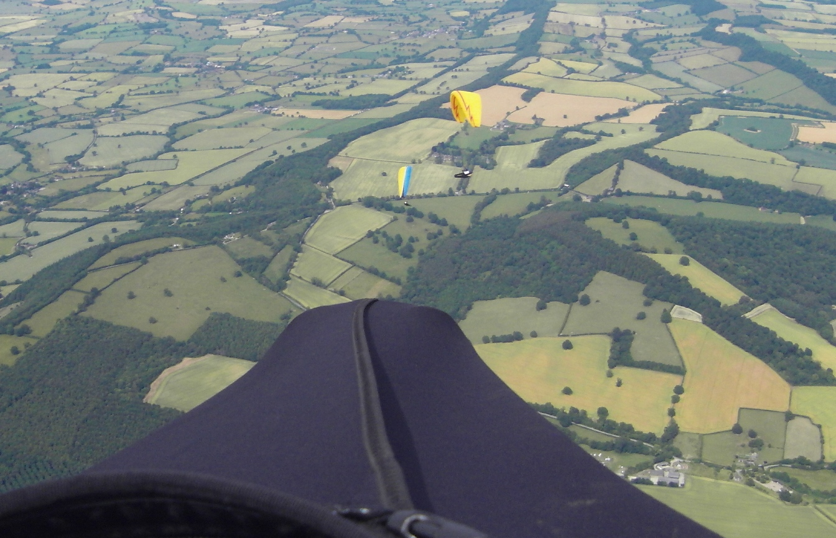
Reading terrain
Reading terrain (using ground sources in the middle/bottom third)
Thermal heating differences – albedo values – strong contrasts between areas
Different ground sources at different times of the day
Trigger points and lines
Visual indicators of thermal release
Entrainment – charcteristics of low level thermals
“Your speed is dictated less by the glider, than by the conditions or as the day changes”

Slide 13
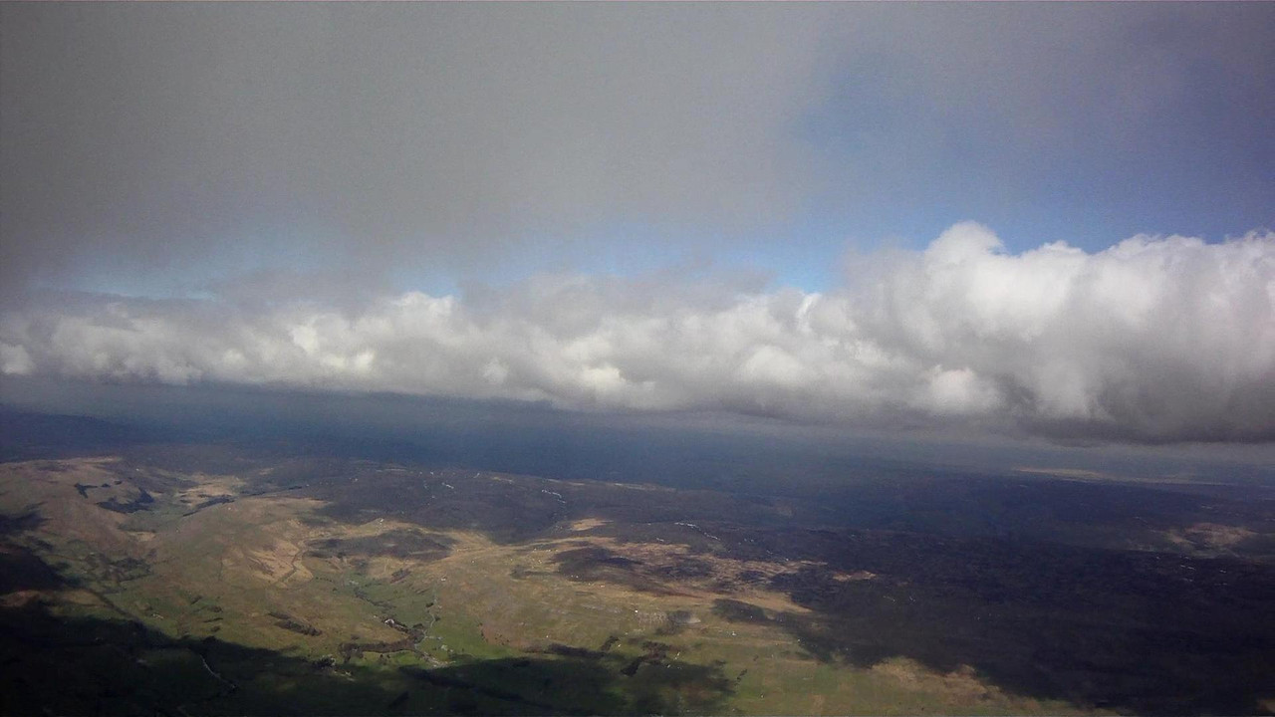
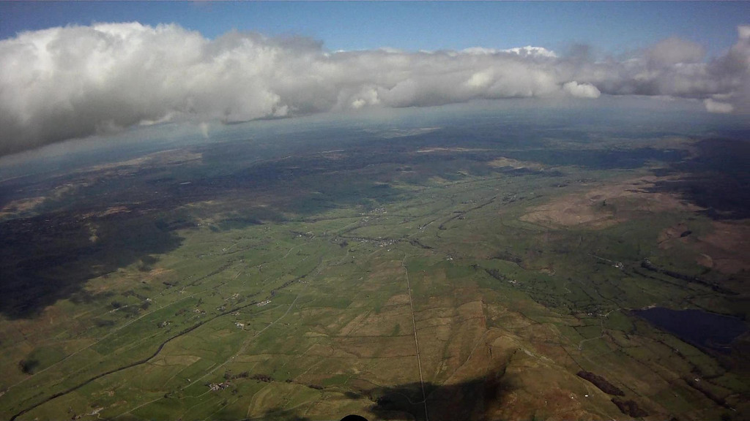
Wind and sun effects
Corollas effect – to veer with height
Cloud streeting
Bending of thermals with height
Effects of sun on valley and adjacent high ground
Wensleydale

Slide 14
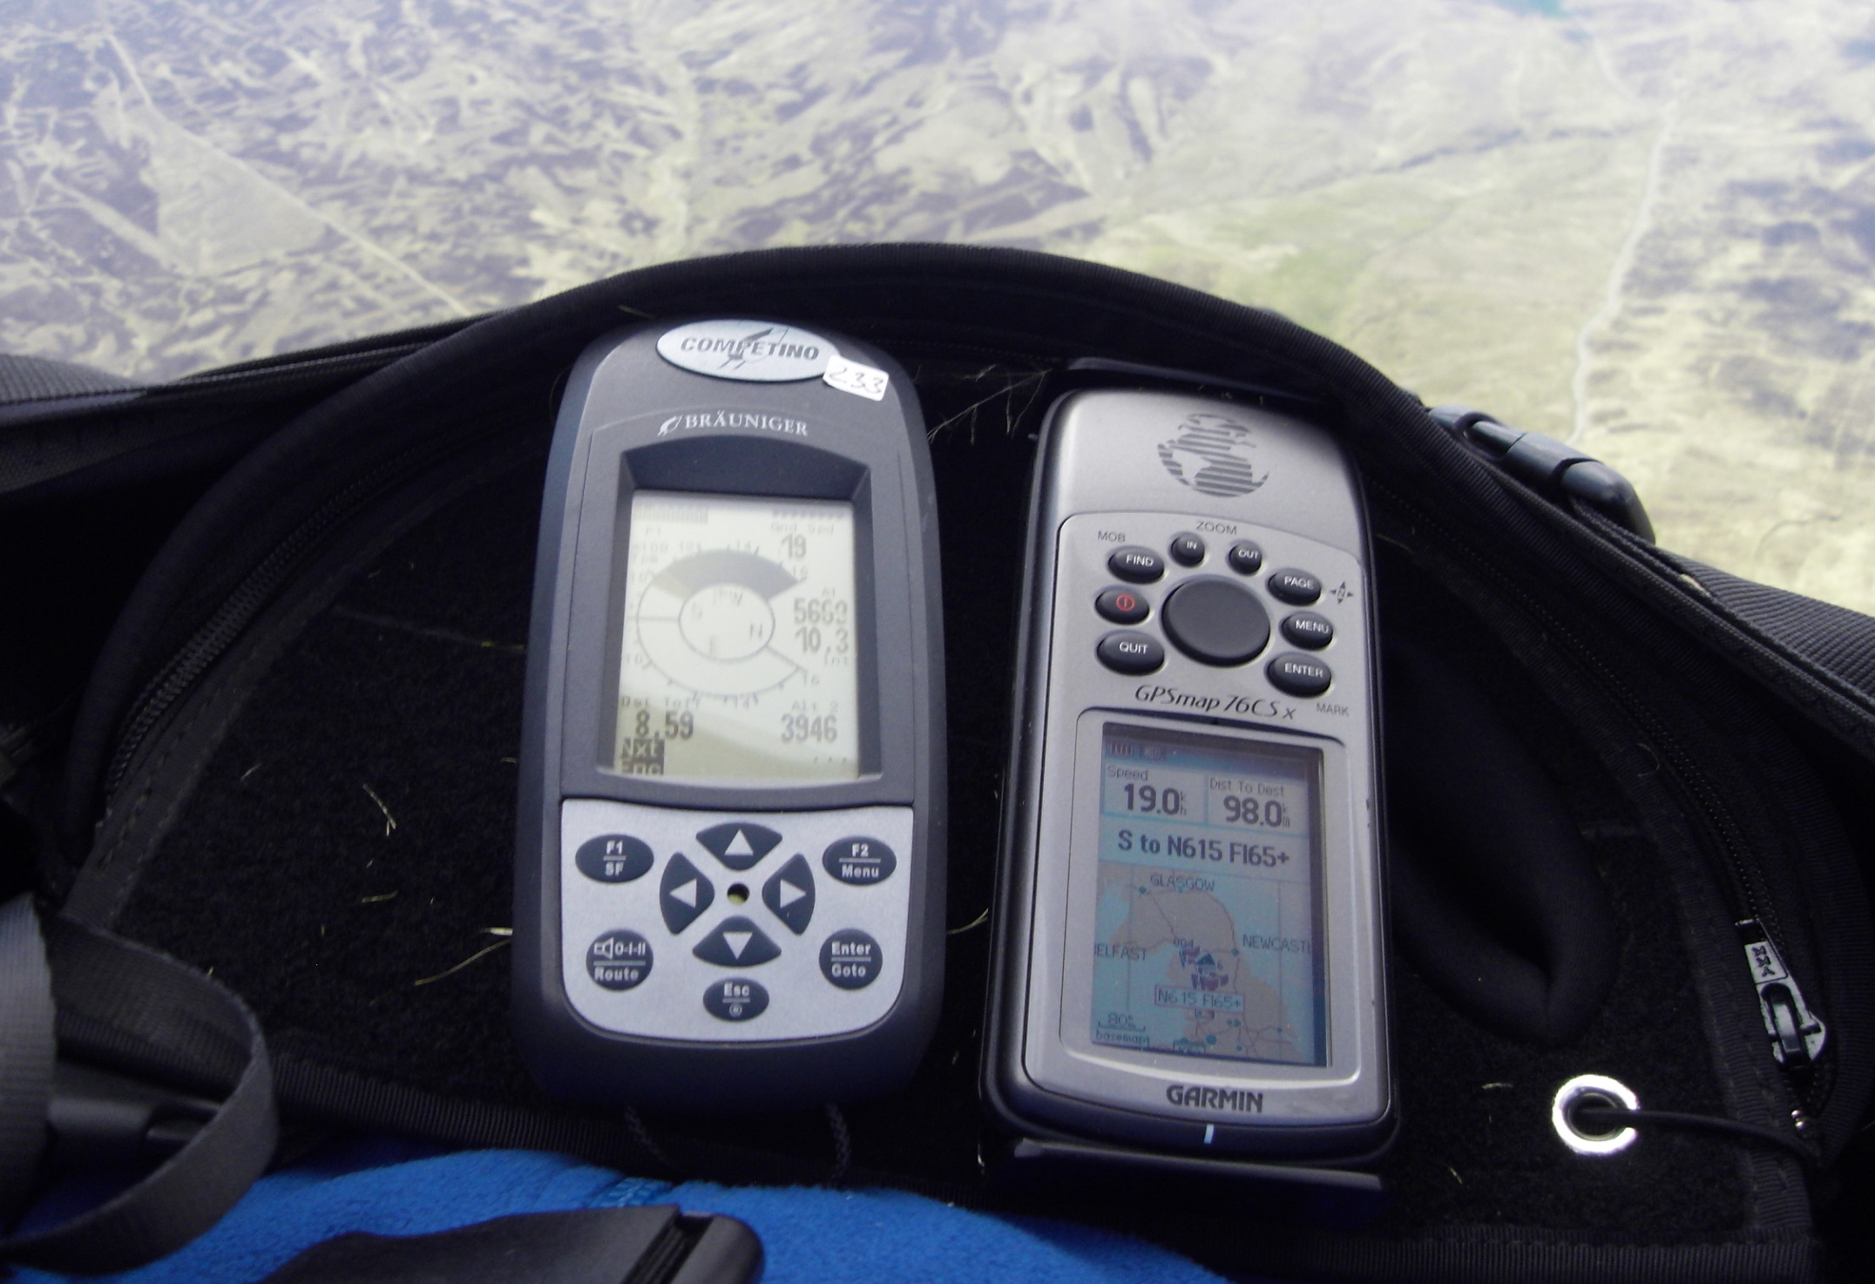
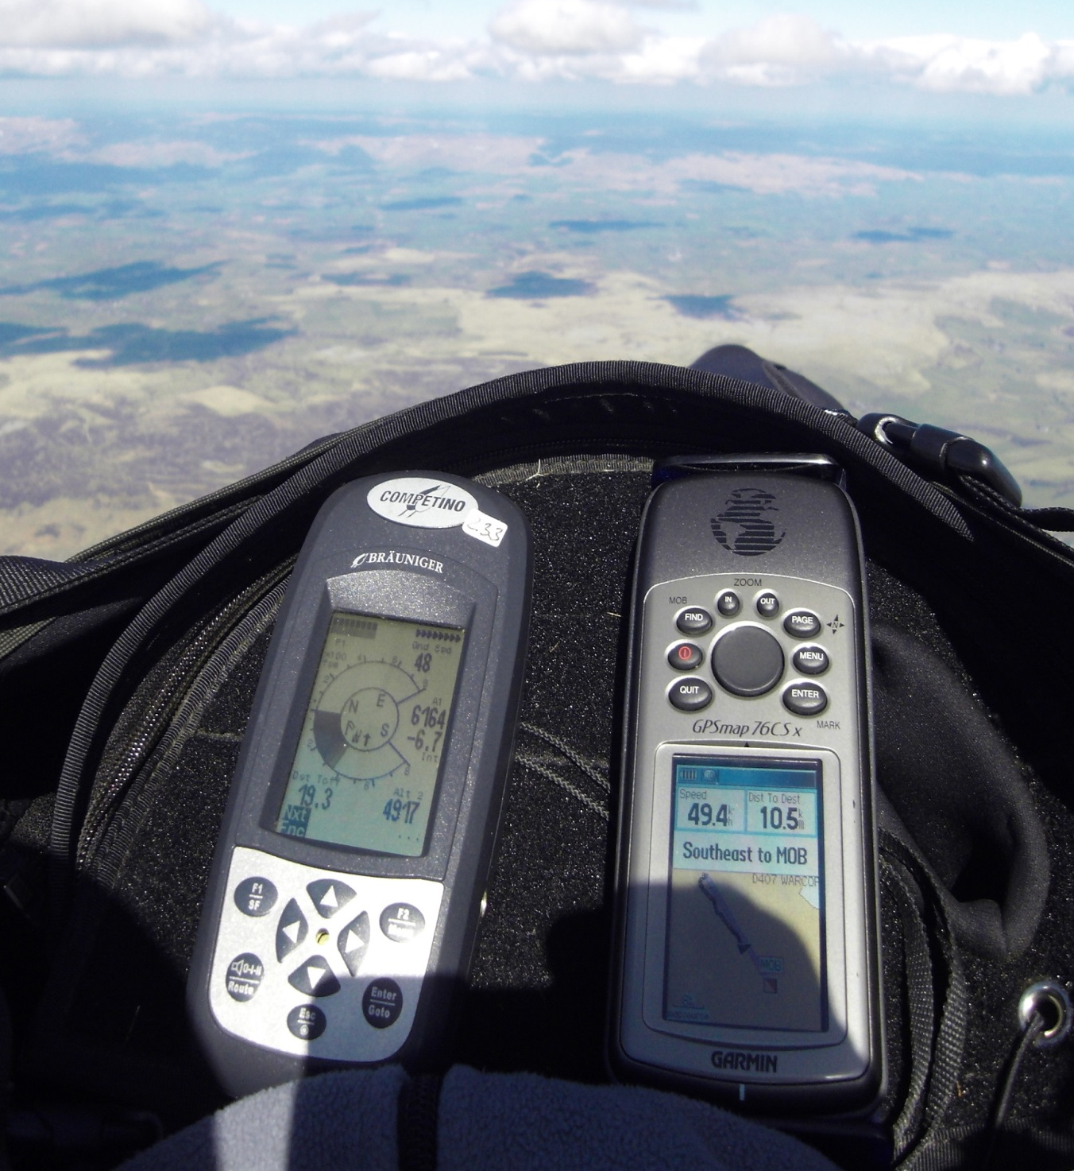
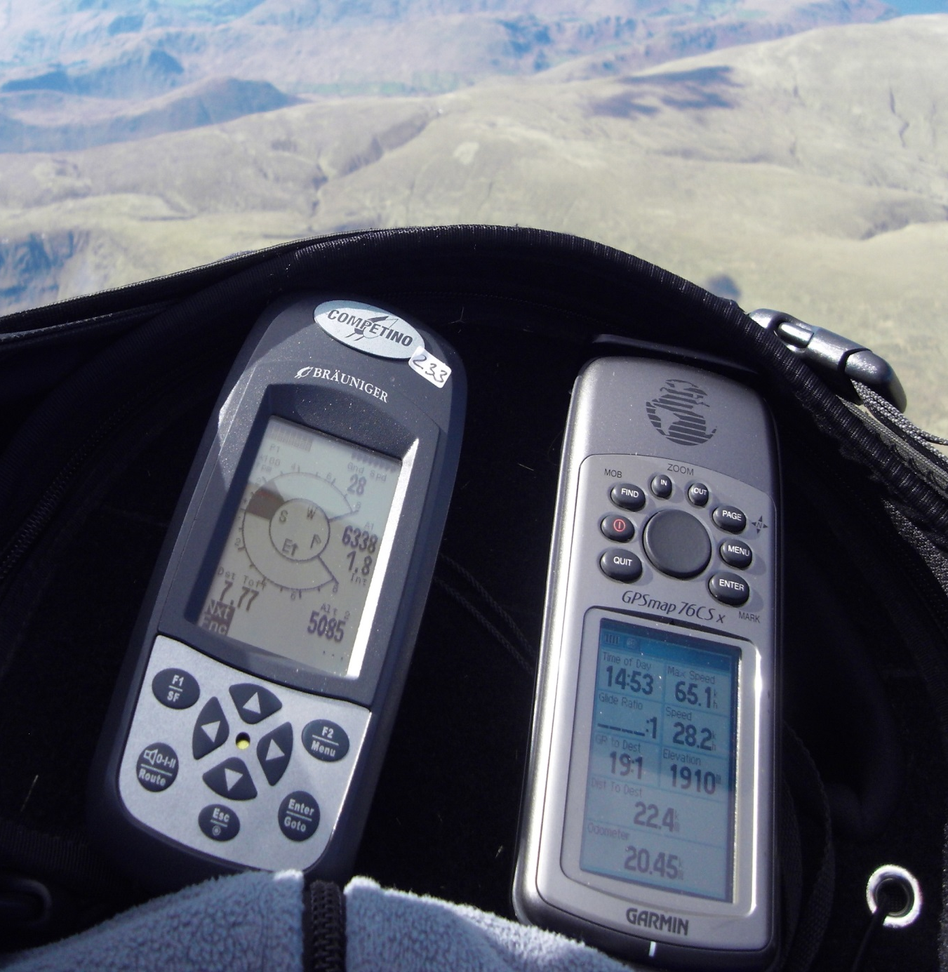
Making effective use of instruments
Useful fields of information
FLIGHT INFO’
Vario – visual/audio?
Ground speed
Height QNF – QNH
Glide angle
Time
Wind speed and direction
Your bearing
NAVIGATION INFO’
Your location
Your track
Airspace
Distances TO(?) goal or TP
GPS enabled and recording a tracklog.

Slide 15
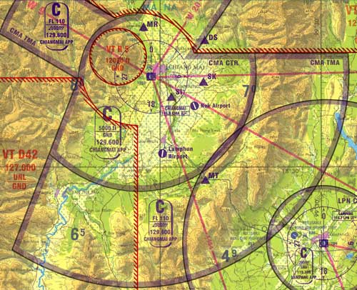
Airspace considerations
buy/study an airspace map
Carry it to be legal
Load airspace onto your GPS
Set GPS mapping to only what
you need – avoid extraneous detail
Know your area
Pre-plan route to avoid airspace
Plan well in advance to avoid airspace
If you fly in some areas then airspace is
a big issue in your route planning and
en-route navigation.
The Lakes has little below FL65 but it
does have some and some D areas.
The Dales is not too bad, but once you
enter the Vale of York it can get more
complex. It depends on the direction you take and the distance from take off.

Slide 16
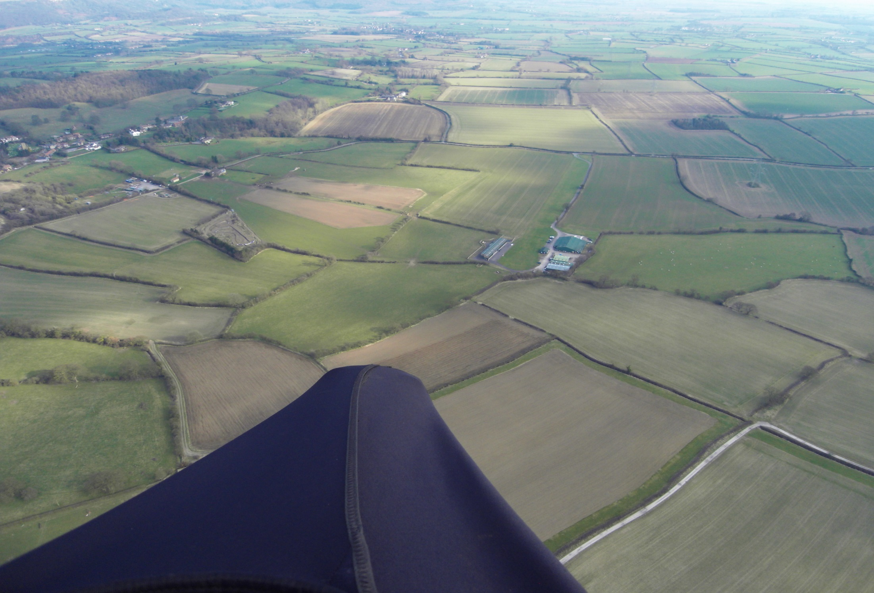
Planning your landing out
Approaches
Don’t push it – or leave it too late
When getting low (below 1000’) give some thought to landing options
Map out the various obstacles/hazards – power lines, masts, fences, trees etc
Plan your approach to go over last ditch, thermal sources
Assess wind direction – your instruments plus ground indicators.
Check that upwind of your chosen field there aren’t rotor hazards if windy
Fine tune your landing options as you get lower – have a plan B and C
Avoid crops, stock – especially horses
Try to make it near a road, village and check the gate location on finals.
After landing
Bundle glider move to side of field
Be courteous if approached
Check mobile signal - pack, eat/drink – look at map
Plan your retrieve – carry a hitching sign
Get to know/ask – bus/train timetables
Co-ordinate with others

Slide 17
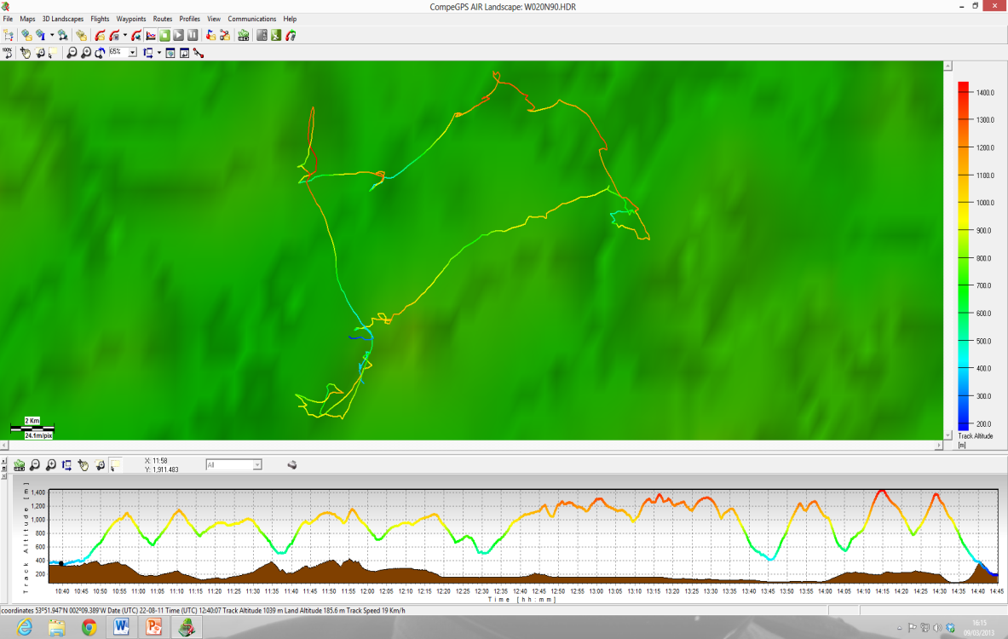
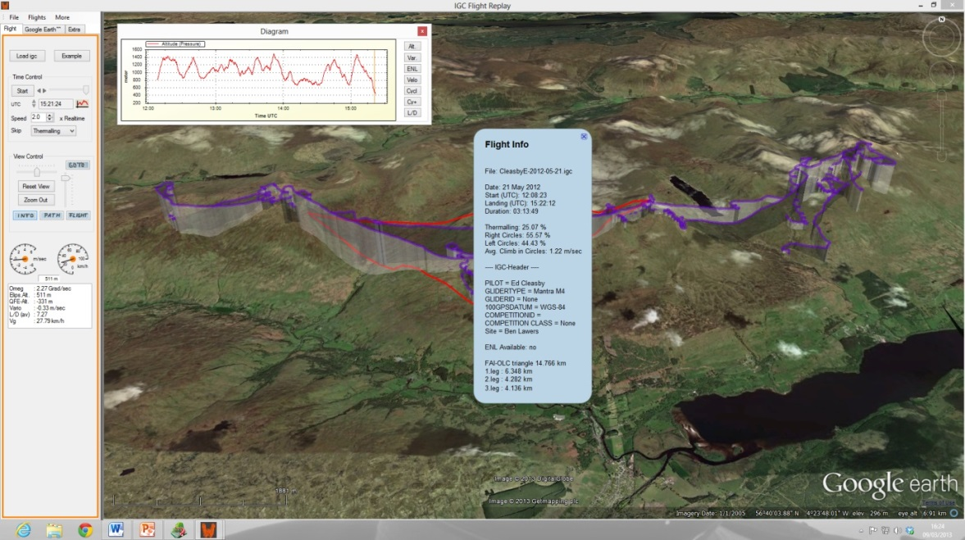
Post flight reflection and analysis
After any xc it’s normally to try to re-live the
excitement of the flight and think about
where you made mistakes or things you
could have done better.
Having photos/video and tracklogs makes
Much easier.
Capture still photos of key decision points
Download and study the tracklog in terms
of
a) the lines you took
b) your thermalling techniques
c) comparing your line against others if
possible
d) the key decision points
e) where thermals were to be found.
What you could learn from your mistakes
– be honest.
What could you do to fly better/further?
Technique, efficiency, composure, equipment,
Knowledge, with others, etc.
SET GOALS

Slide 18
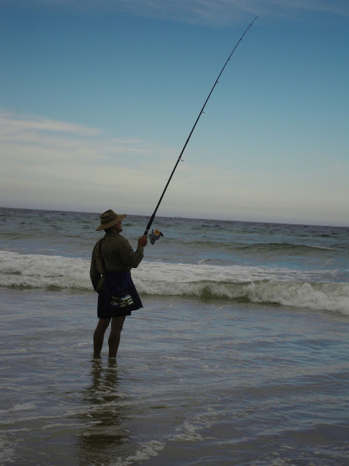
Other stuff
SIV/pilotage
Emergency equipment
Vol biv
Study books/videos
Courses

